Slide 1
Number system - 4
Factor and Multiple – meaning and understanding
HCF and LCM – meaning and understanding
Prime factorization
HCF and LCM by Prime factorization
Basic Properties of HCF and LCM

Slide 2

N divided by A
Remainder = 0
(N is divisible by A)
Factors, HCF, Properties of factors, properties and applications of HCF
Multiples, LCM, properties and applications of LCM
Remainder ≠ 0
Properties of remainder, Concept of last digit

Slide 3
Factors & Multiples
A factor is a number that can completely divide a number greater than or equal to it. For example, 2 is a factor of 4 and 3 is a factor of 15, but 2 is not a factor of 15.
On the other hand, a multiple is a number that may be divided by another number a certain number of times without leaving a remainder. So, 4 is a multiple of 2, 15 is a multiple of 3, but 15 is not a multiple of 2 since dividing 15 by 2 will leave a remainder of 1.
So, if 12 is divisible by 4 then we can say that-
A) 4 is the factor of 12
B) 12 is the multiple of 4
Important- Remember that every number is largest factor and smallest multiple of itself
Factor Foundation Rule
If a is a factor of b, and b is a factor of c, then a is also a factor of c. For example, 3 is a factor of 9 and 9 is a factor of 81. Therefore, 3 is also a factor of 81.

Slide 4
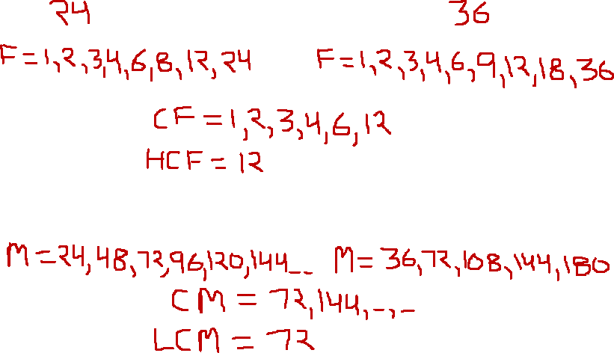
Basic understanding of HCF and LCM
For 24 and 36

Slide 5
HCF and LCM
HCF
The Highest common factor or HCF is the highest common factor among all the factors of a set of given numbers. It is also known as the greatest common factor (GCF) or the greatest common divisor
Example- the HCF of 24 and 36 will be 12, since 12 is the largest number that can evenly divide into both 24 and 36.
LCM
The LCM is the least common multiple of any set of given numbers. Least Common Multiple refers to the smallest multiple of two (or more) integers. Multiples will be equal to or larger than the starting integers.
Example- The LCM of 24 and 36 is 72 because 72 is the smallest number that both 24 and 36 can divide.

Slide 6
How to find HCF and LCM for large numbers
We can easily calculate HCF and LCM for smaller numbers like 24 and 36 (as done in last to last slide)
But in case there are 2 large numbers like 360 and 540, the same approach will be cumbersome and tedious
In such cases, we need to use prime factorization

Slide 7
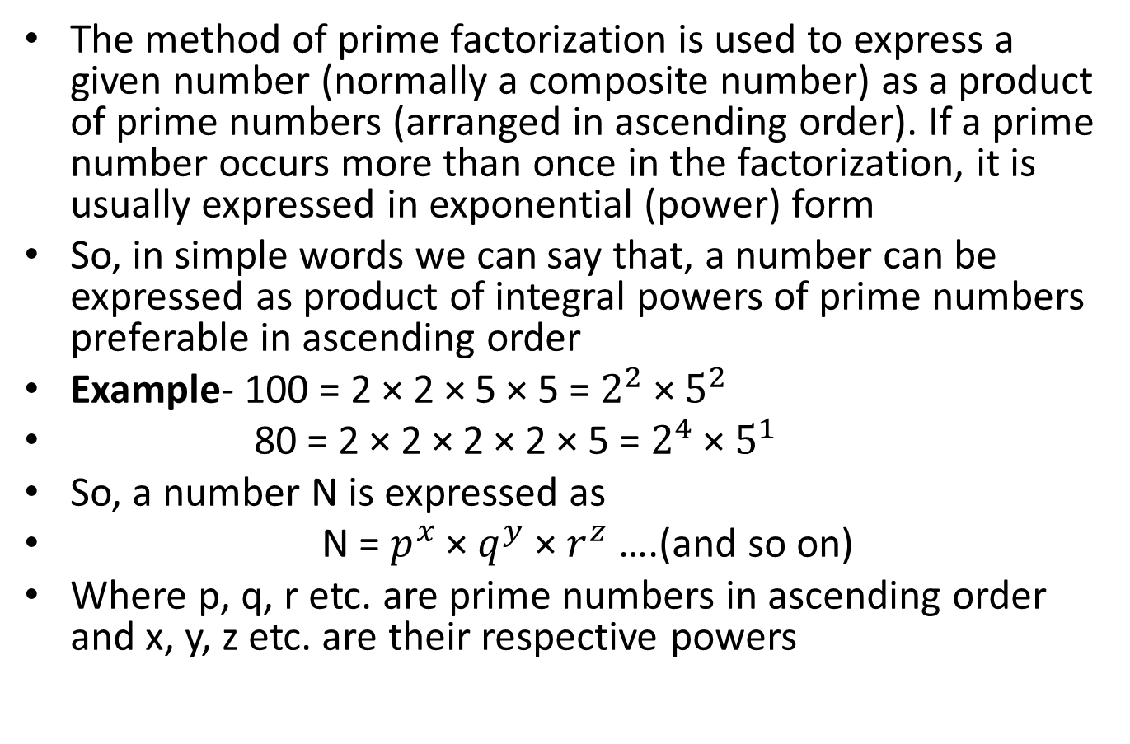
Prime Factorization
The method of prime factorization is used to express a given number (normally a composite number) as a product of prime numbers (arranged in ascending order). If a prime number occurs more than once in the factorization, it is usually expressed in exponential (power) form
So, in simple words we can say that, a number can be expressed as product of integral powers of prime numbers preferable in ascending order
Example- 100 = 2 × 2 × 5 × 5 = $2^{2}$ × $5^{2}$
80 = 2 × 2 × 2 × 2 × 5 = $2^{4}$ × $5^{1}$
So, a number N is expressed as
N = $p^{x}$ × $q^{y}$ × $r^{z}$ ….(and so on)
Where p, q, r etc. are prime numbers in ascending order and x, y, z etc. are their respective powers

Slide 8
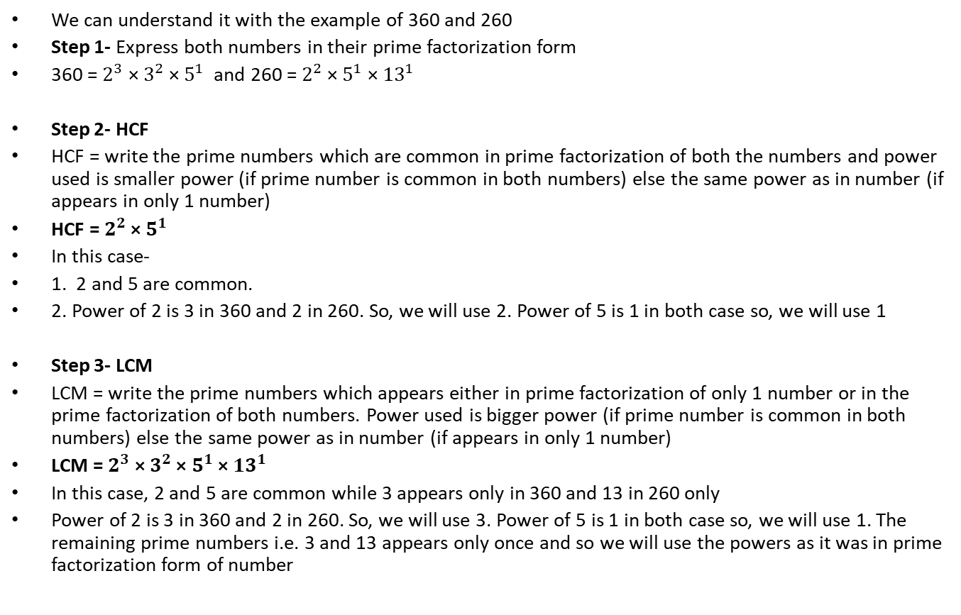
HCF and LCM by Prime factorization
We can understand it with the example of 360 and 260
Step 1- Express both numbers in their prime factorization form
360 = $2^{3}$ × $3^{2}$ × $5^{1}$ and 260 = $2^{2}$ × $5^{1}$ × ${13}^{1}$
Step 2- HCF
HCF = write the prime numbers which are common in prime factorization of both the numbers and power used is smaller power (if prime number is common in both numbers) else the same power as in number (if appears in only 1 number)
HCF = $2^{2}$ × $5^{1}$
In this case-
1. 2 and 5 are common.
2. Power of 2 is 3 in 360 and 2 in 260. So, we will use 2. Power of 5 is 1 in both case so, we will use 1
Step 3- LCM
LCM = write the prime numbers which appears either in prime factorization of only 1 number or in the prime factorization of both numbers. Power used is bigger power (if prime number is common in both numbers) else the same power as in number (if appears in only 1 number)
LCM = $2^{3}$ × $3^{2}$ × $5^{1}$ × ${13}^{1}$
In this case, 2 and 5 are common while 3 appears only in 360 and 13 in 260 only
Power of 2 is 3 in 360 and 2 in 260. So, we will use 3. Power of 5 is 1 in both case so, we will use 1. The remaining prime numbers i.e. 3 and 13 appears only once and so we will use the powers as it was in prime factorization form of number

Slide 9
Examples
Example 1- Find HCF and LCM for 260 and 1080
Example 2- Find HCF and LCM for 240 and 360

Slide 10
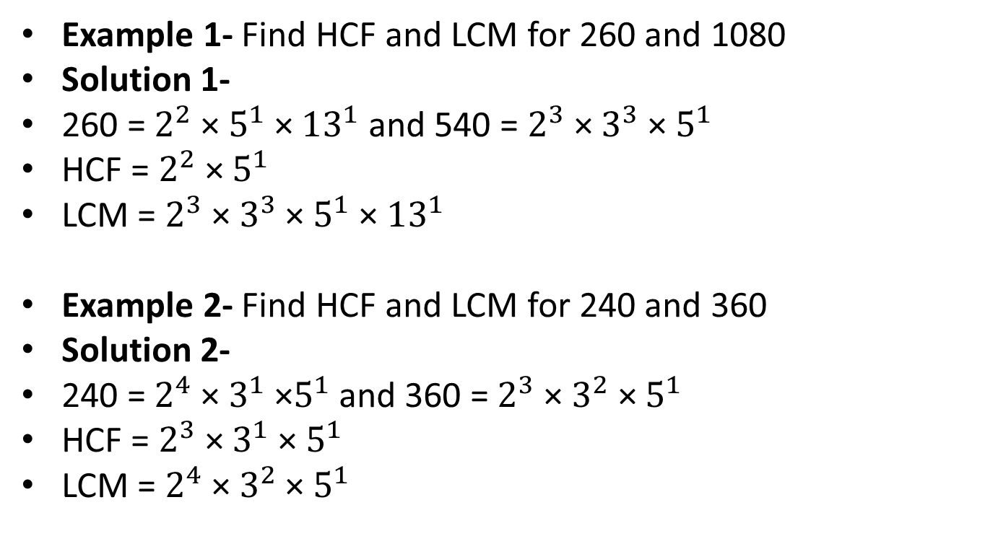
Solutions
Example 1- Find HCF and LCM for 260 and 1080
Solution 1-
260 = $2^{2}$ × $5^{1}$ × ${13}^{1}$ and 540 = $2^{3}$ × $3^{3}$ × $5^{1}$
HCF = $2^{2}$ × $5^{1}$
LCM = $2^{3}$ × $3^{3}$ × $5^{1}$ × ${13}^{1}$
Example 2- Find HCF and LCM for 240 and 360
Solution 2-
240 = $2^{4}$ × ${3^{1}\text{ ×}5}^{1}$ and 360 = $2^{3}$ × $3^{2}$ × $5^{1}$
HCF = $2^{3}$ × $3^{1}$ × $5^{1}$
LCM = $2^{4}$ × $3^{2}$ × $5^{1}$

Slide 11
Basic properties of HCF and LCM
Property 1- For 2 numbers (say A and B) their product is same as product of their LCM and HCF
A × B = HCF × LCM
Example- HCF and LCM of 24 and 36 are 12 and 72 respectively
24 × 36 = 12 × 72
But, this property do not hold good for 3 numbers unless and until they are pair wise co-prime
Example 1- For 10, 15 and 20 the HCF = 5 and LCM = 60
It is clear that, 10 × 15 × 20 ≠ 5 × 60
Example 2- For 4, 9 and 10 the HCF = 1 and LCM = 180
4, 9 and 10 are co-prime
But, 4 × 9 × 10 ≠ 1 × 180
It is so, because 4, 9 and 10 are pairwise not co-prime
( 4 and 9 are co-prime, 9 and 10 are co-prime but, 4 and 10 are not co-prime)
Example 3- For 4, 9 and 25 the HCF = 1 and LCM = 900
Clearly, 4 × 9 × 25 = 1 × 900
In this case, 4, 9 and 25 are co-prime and also these are pairwise co-prime (i.e. 4 and 9 are co-prime, 9 and 25 are co-prime and 4 and 25 are co-prime)

Slide 12
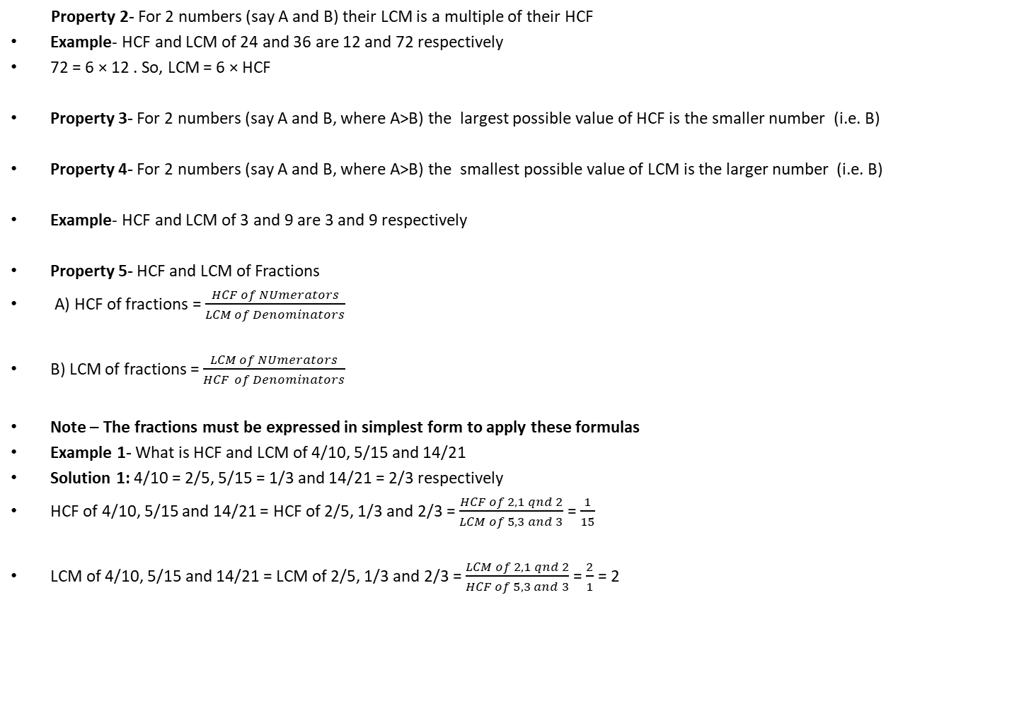
Basic properties of HCF and LCM
Property 2- For 2 numbers (say A and B) their LCM is a multiple of their HCF
Example- HCF and LCM of 24 and 36 are 12 and 72 respectively
72 = 6 × 12 . So, LCM = 6 × HCF
Property 3- For 2 numbers (say A and B, where A>B) the largest possible value of HCF is the smaller number (i.e. B)
Property 4- For 2 numbers (say A and B, where A>B) the smallest possible value of LCM is the larger number (i.e. B)
Example- HCF and LCM of 3 and 9 are 3 and 9 respectively
Property 5- HCF and LCM of Fractions
A) HCF of fractions = $\frac{HCF of NUmerators}{LCM of Denominators}$
B) LCM of fractions = $\frac{LCM of NUmerators}{HCF of Denominators}$
Note – The fractions must be expressed in simplest form to apply these formulas
Example 1- What is HCF and LCM of 4/10, 5/15 and 14/21
Solution 1: 4/10 = 2/5, 5/15 = 1/3 and 14/21 = 2/3 respectively
HCF of 4/10, 5/15 and 14/21 = HCF of 2/5, 1/3 and 2/3 = $\frac{HCF of 2, 1 qnd 2}{LCM of 5, 3 and 3}$ = $\frac{1}{15}$
LCM of 4/10, 5/15 and 14/21 = LCM of 2/5, 1/3 and 2/3 = $\frac{LCM of 2, 1 qnd 2}{HCF of 5, 3 and 3}$ = $\frac{2}{1}$ = 2

